Slide 1


Cyclistic Case Study Analysis
Prepared By:
Starrie

Slide 2
Introduction
Cyclistic is a Bike-Share program that features 5,824 bicycles and 692 docking stations across Chicago
Majority of Cyclistic’s Riders opt for Traditional Bikes and about 8% of Riders use Assistive Bikes
Riders are more likely to ride for leisure, but about 30% ride for daily commute to work
Cyclistic has 2 Types of Customers:
Casual Riders: Customers who purchase single-ride or full-day passes
Members: Customers who purchase Annual Memberships

Slide 3
Objective
To Convert Casual Riders to Annual Members by understanding their usage patterns

Slide 4
Understanding the Dataset
Data is organized in a CSV file by respective month
Data for Year of 2022 (12 months) is selected for this analysis
13 Columns (Variables)
5,667,717 Rows
Data contains information on
Trip start day and time
Trip end day and time
Trip start and end station
Latitude and Longitude of Trip start and end station
Rider type

Slide 5
Assumptions Made
Any trips below or equals to 60 seconds (<= 60 seconds) in length are assumed to be potentially false starts or users trying to re-dock a bike to ensure it was secure, hence Erroneous value rows are removed from the Dataset.
Any trips above 86,400 seconds (> 24 hours) in length are considered rare occurrences (Outliers) and as it makes up a small percentage of 0.09% (5,360 out of total 5,667,717 records) of the original dataset, Outlier value rows are removed from the Dataset.

Slide 6
Data Cleaning
1,375,912 Records of Dirty Data (with NULL or Erroneous Values) are removed:
1,298,357 Records with NULL values from 8 Columns to be removed
Columns 5 to 12 on Start and End Station Id and Name, Start and End Latitude and Longitude
Rows with Erroneous and Outlier values in Column 19 on Trip Duration (in seconds) are removed where:
trip_duration_second <= 0 (Erroneous) OR
trip_duration_second <= 60 (Erroneous) OR
trip_duration_second >= 86400 (Outliers)
There is a total of 4,291,805 Records after data is cleaned.

Slide 7
Data Cleaning
8 New Columns Added
Column 14: started_date - Date each ride started based on Column 2 started_at; Return Date in YYYY-MM-DD Format
Column 15: started_month - Month each ride started based on Column 2 started_at; Return Month in MONTH Name Format
Column 16: started_day_of_week - Day of the Week that each ride started based on Column 2 started_at; Return Day of the Week Name Value (Monday to Sunday)
Column 17: started_time - Time each ride started based on Column 2 started_at; Return Time Value in HH:MM:SS Format
Column 18: started_time_of_day - Time of Day Category each ride started based on Column 2 started_at; Return Time of Day Category (Early Morning, Morning, Afternoon, Night) in String Value
Column 19: trip_duration_second - Calculated Ride Length in Seconds based on Difference of Column 3 and 2 ended_at and started_at; Return Trip Duration in Seconds
Column 20: trip_duration_minute - Calculated Ride Length in Minutes based on Difference of Column 3 and 2 ended_at and started_at; Return Trip Duration in Minutes
Column 21: trip_route - Concatenated start and end station name based on Column 5 and 7 start_station_name and end_station_name; Return Trip Start and End Route in String Value

Slide 8
Data Insights
Based on 2022 Cyclistic Trip Dataset

Slide 9
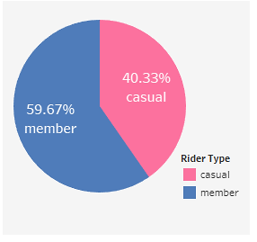
Total Rides by Rider Type
Insights Drawn
Majority of the rides are contributed by Riders who are already Members
There is a significant group of Casual Riders using Cyclist Bikes

Slide 10
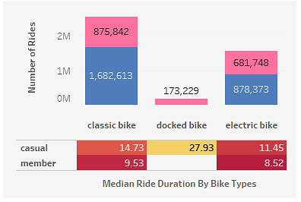
Breakdown of Rides Usage by Bike Type
Insights Drawn
Members do not use Docked Bikes
Majority of Riders prefer Classic Bikes
A small group of Casual Riders uses Docked Bikes

Slide 11
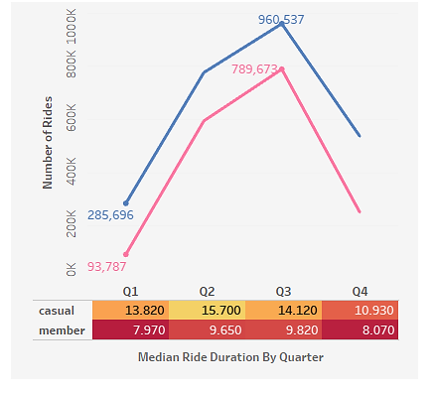
Rides Distribution by Quarter
Insights Drawn
Higher rides usage observed during Quarter 3 of the year (Summer).
Climate differences can possibly affect rides pattern
Casual Riders ride for a longer duration per trip (10 to 15 minutes) in general compared to Members
Members generally have a shorter trip duration (less than 10 minutes)

Slide 12
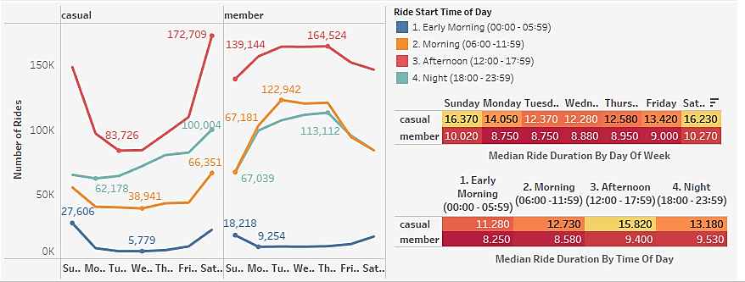
Rides Distribution by Day
Insights Drawn
Members practice a more consistent ride pattern across the week
Number of rides is highest on Saturday for Casual Riders and Thursday for Members
Riders generally start riding in the Afternoon
Longer trips observed on weekends for both Casual Riders and Members
Median Ride Duration varies more for Casual Riders (12.280 – 16.370 mins) unlike Members (8.750 – 10.270 mins)

Slide 13
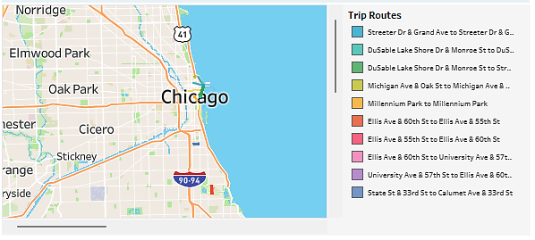
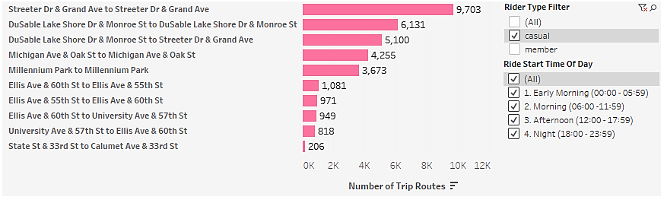
Top 10 Popular Routes for Casual Riders
Insights Drawn
Popular Route varies across different timings of the day
Most Popular Route by Casual Riders appears to be a round trip commencing and ending at Streeter Dr & Grand Ave

Slide 14
Recommendations
Introduce more marketing content based on the Top 10 Popular Routes for Casual Riders
Traditional Media along these routes
Organize roadshows during popular periods (Summer Season: Q3 of the Year, Saturday) with higher number of Casual Riders
Digital Media (e.g. email campaigns) can be launched during this period to raise awareness of the membership benefits
Create new member packages tailored to Casual Riders’ needs
Membership plans which focuses on Weekends usage
Monthly plans to allow more flexibility to commit specific periods
Launch a rewards program which allow members to accumulate points for riding a certain distance

